Slide 1

Analysis of Motor Vehicle Crashes
(2014,2015 and 2016)

Slide 2
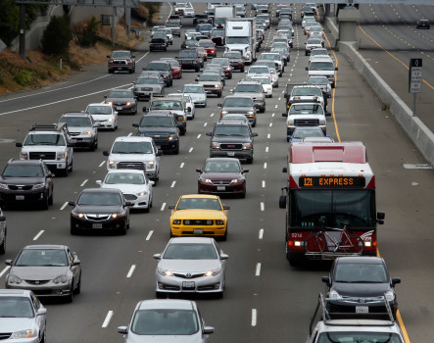
The United States
Overview
is one of busiest countries in terms of road traffic:
264 million vehicles registered
218 million drivers
Number of collisions/accidents have increased significantly…
Multiple factors contributing to accidents – road safety, driver skill, impairment due to alcohol, notably speeding etc
Important to understand the top causes contributing to increase in accidents and take actions to increase safety

Slide 3
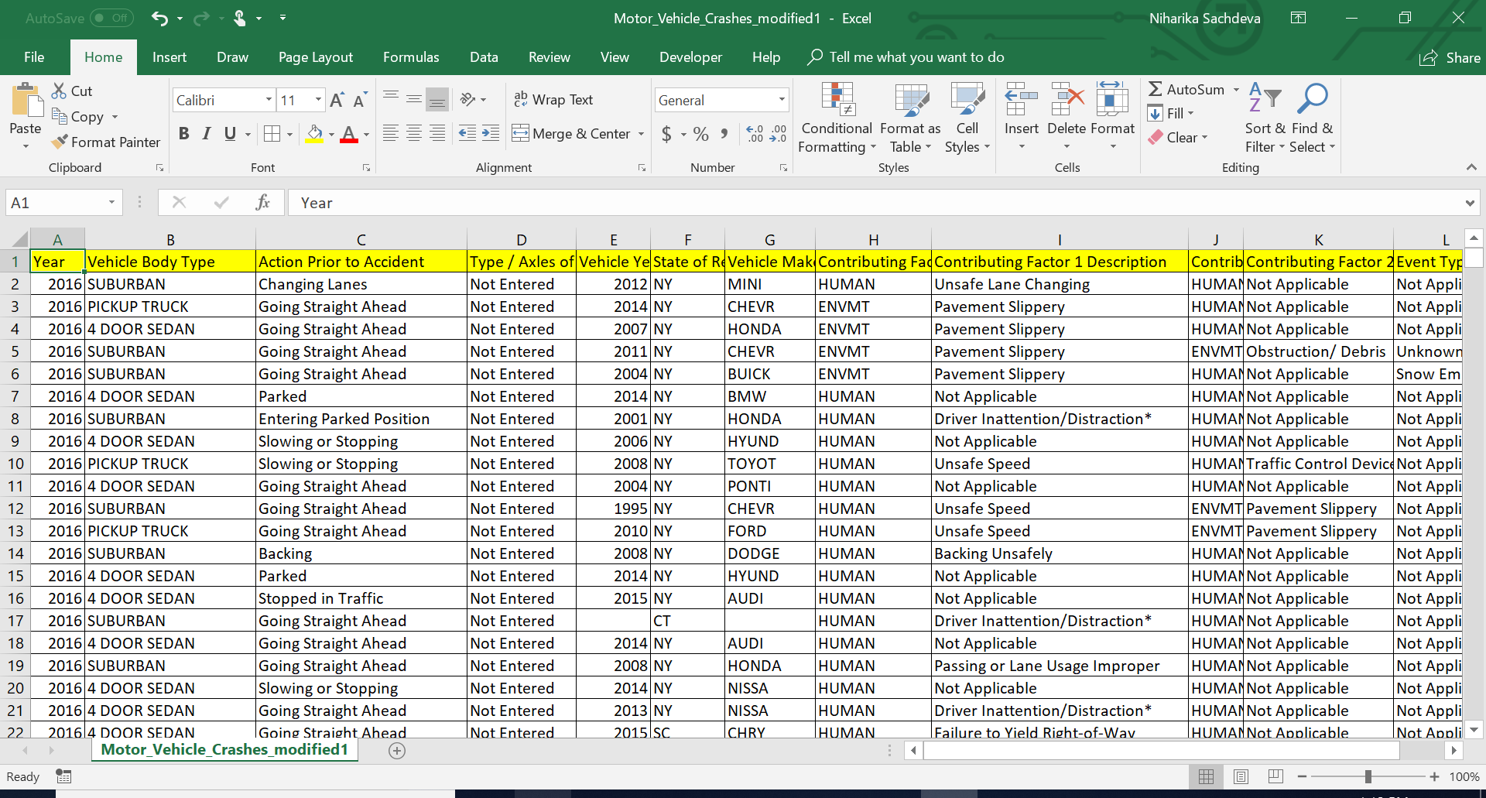
Data Used for Analysis (data.gov)

Slide 4
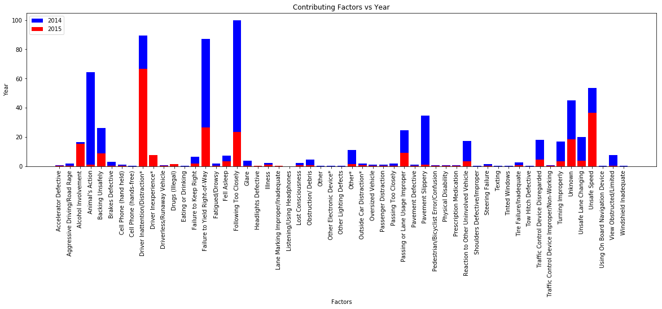
Top 5 factors contributing to Accidents
87043 Accidents in 2014, 2015
Top 5 factors contributing to accidents:
Following too closely
Driver Inattention/distraction
Failure to yield right-to-way
Animal’s action
Unsafe speed

Slide 5
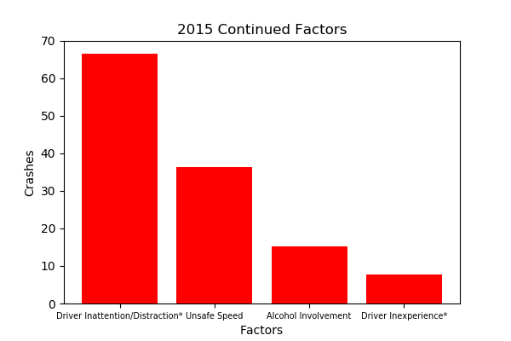
Factors contributing to Accidents – Continued in 2015
Driver Inattention/distraction
Unsafe speed
Alcohol Involvement
Driver Inexperience
Inference
Increased traffic enforcement
Stringent control/penalties on alcohol involvement, use of mobile phones while driving
Improved driving habits.

Slide 6
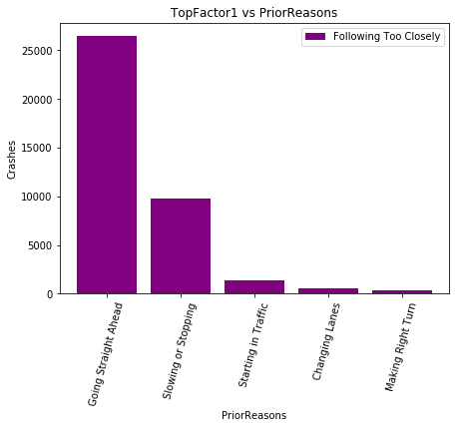
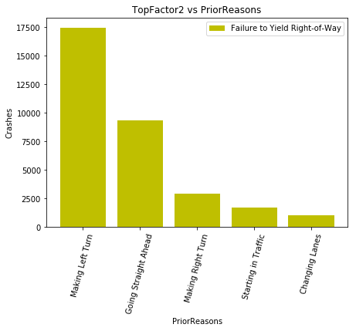
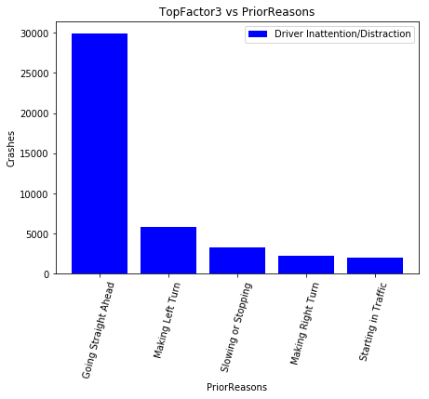
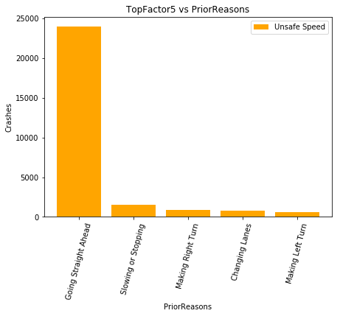
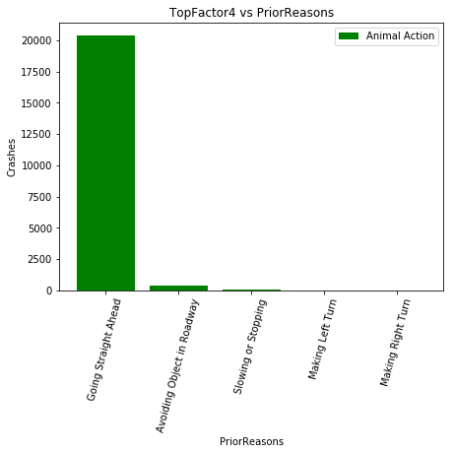
What happened before the accidents?
Prior Reasons before the accident for top five contributing factors and inferred the following:
Going straight ahead is common across all accident types. Which means that its not caused by the car but due to human causes – bad driving habits, alcohol involvement, speeding etc.
Making Left turn,
Slowing or stopping is another common occurrence:

Slide 7
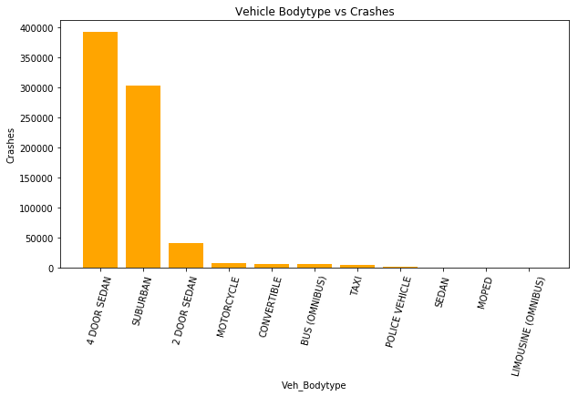
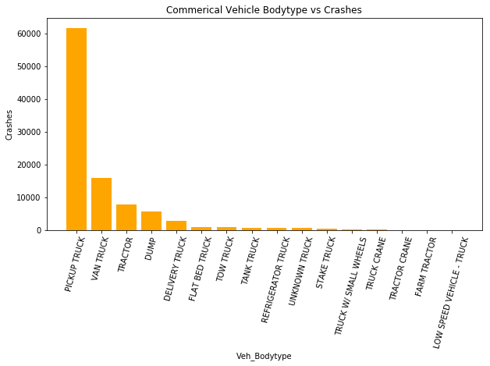
Which Vehicles are prone to accidents?
Commercial Vehicles
Pickup Truck shows the maximum
count
Commercial Vehicle Body Type
Passenger Vehicles
Sedan Cars encountered max crashes.
Suburban is the next.

Slide 8
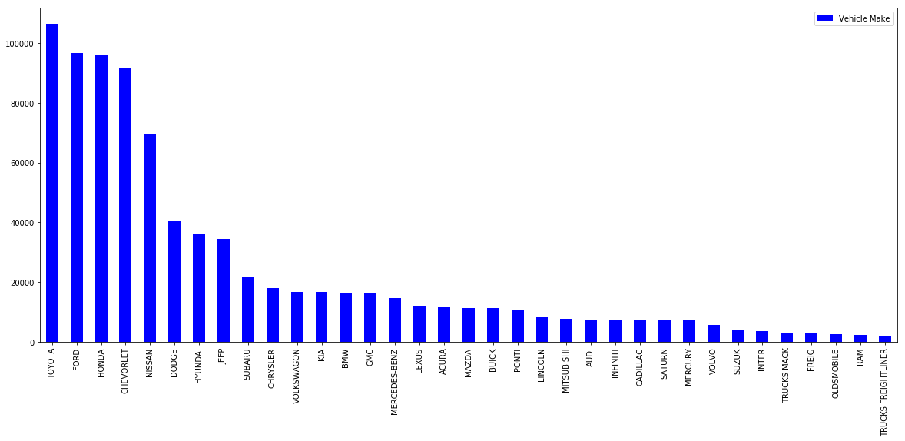
Top 35 car companies
Number of cars

Slide 9
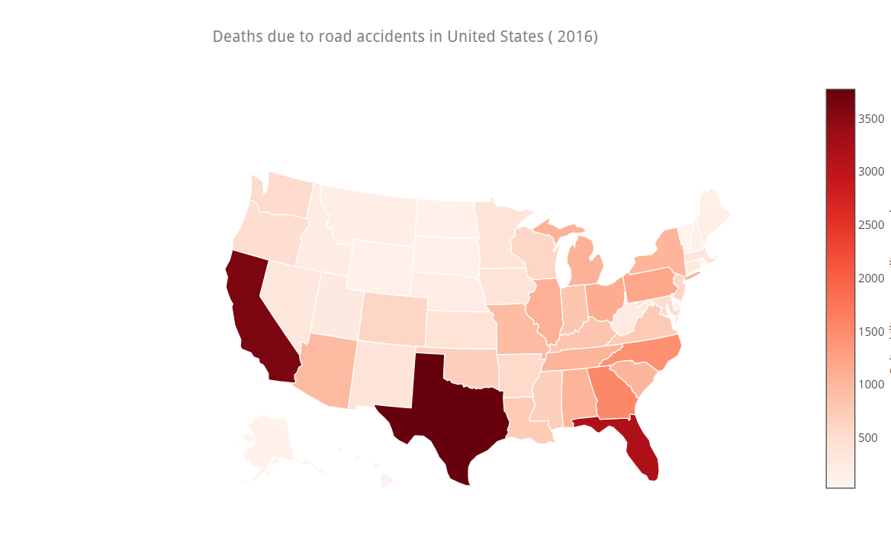
Deaths due to car accidents(2016)
Colors getting darker in states Texas, California, Florida represent higher number of deaths due to car accidents.

Slide 10
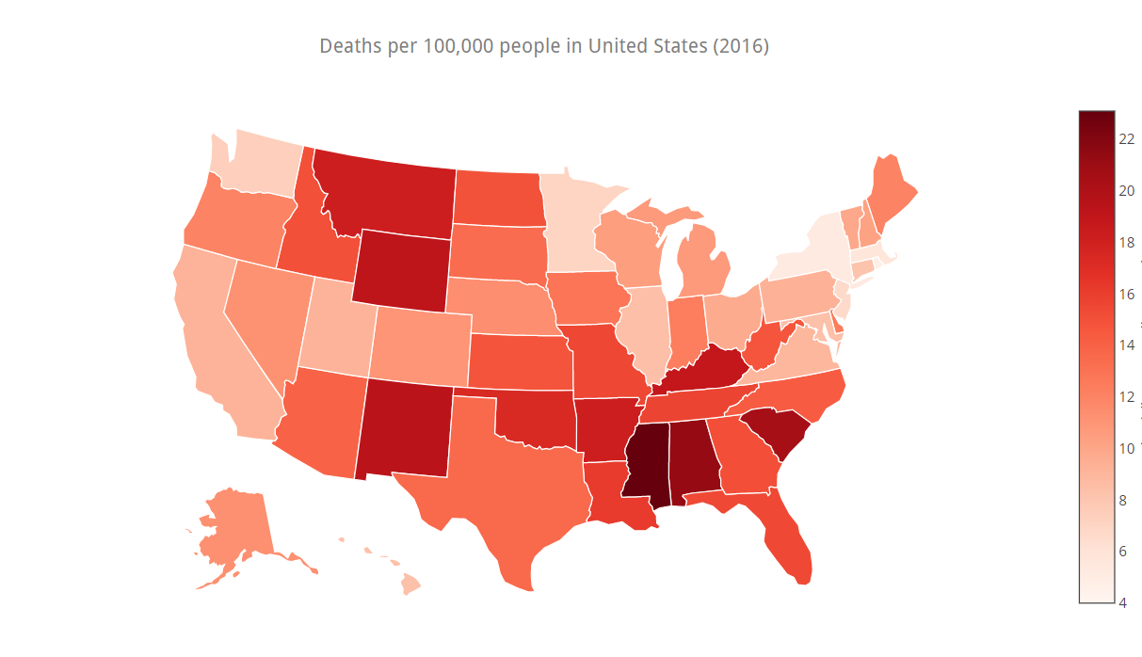
Deaths per 100,000 due to car accidents(2016)

Slide 12
Thank you.

